Slide 1
Lambda Functions

Slide 2
What are Lambda Functions?
lambda keyword to declare an anonymous function
An anonymous function refers to a function declared with no name
lambda functions behave in the same way as regular functions that are declared using the def keyword.

Slide 3

Characteristics of Lambda functions
A lambda function can take any number of arguments, but they contain only a single expression.
An expression is a piece of code executed by the lambda function, which may or may not return any value.
Lambda functions can be used to return function objects.
Syntactically, lambda functions are restricted to only a single expression.

Slide 4


Lambda Functions
The lambda operator cannot have any statements and it returns a function object that we can assign to any variable.
The num is the argument
num % 2 is the expression that is evaluated and the result of the expression is returned.
Same as :

Slide 5

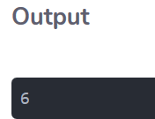
Lambda Functions
Another example –

Slide 6
Why Use Lambda Functions?
Lambda functions are used when you need a function for a short period of time.
This is commonly used when you want to pass a function as an argument to higher-order functions, that is, functions that take other functions as their arguments.

Slide 7
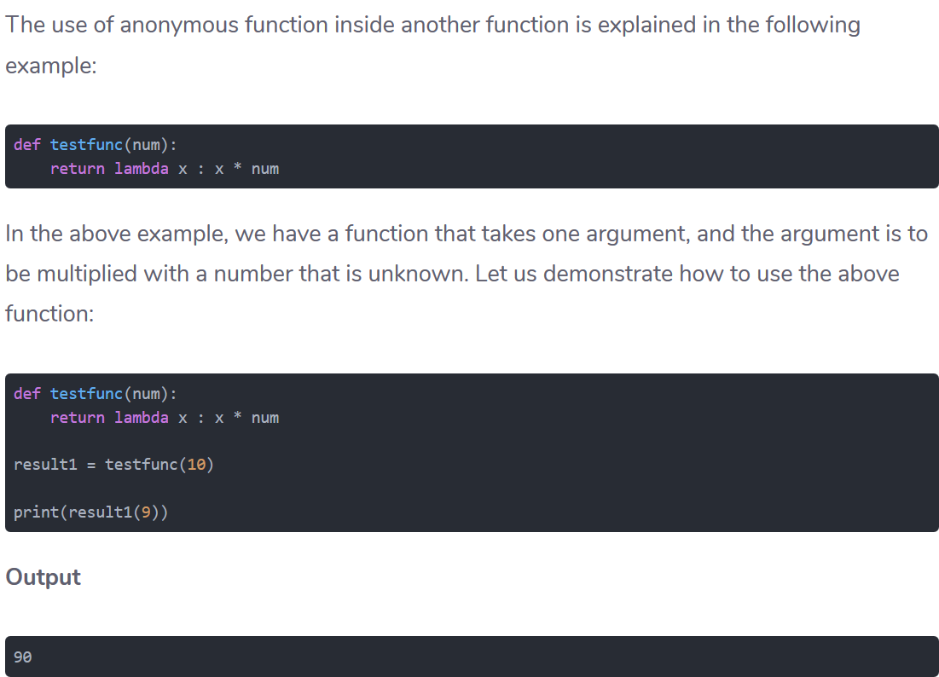

Slide 8
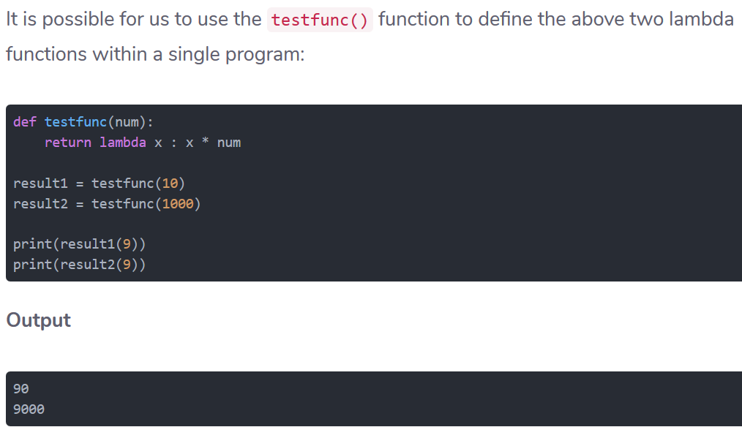

Slide 9
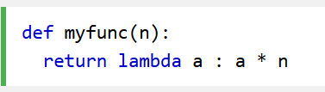
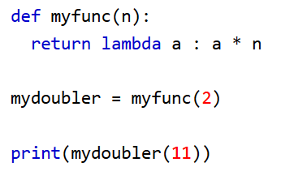
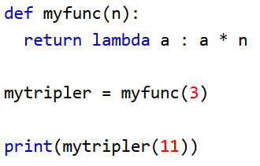
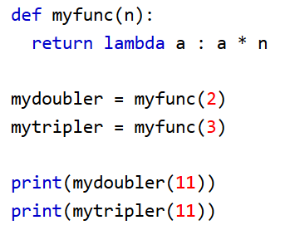
The power of lambda is better shown when you use them as an anonymous function inside another function.
Say you have a function definition that takes one argument, and that argument will be multiplied with an unknown number:
Use that function definition to make a function that always doubles the number you send in:

Slide 10

The filter() Function
The Python's filter() function takes a lambda function together with a list as the arguments. It has the following syntax:
The object here should be a lambda function which returns a boolean value.
The object will be called for every item in the iterable to do the evaluation. The result is either a True or a False for every item

Slide 11
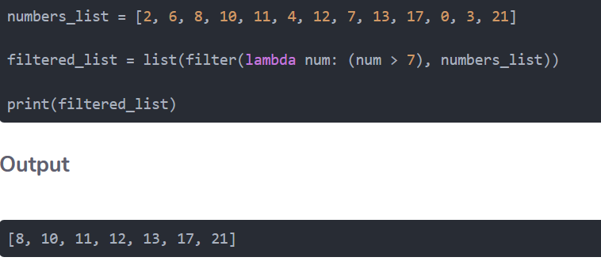
The Filter() function

Slide 12
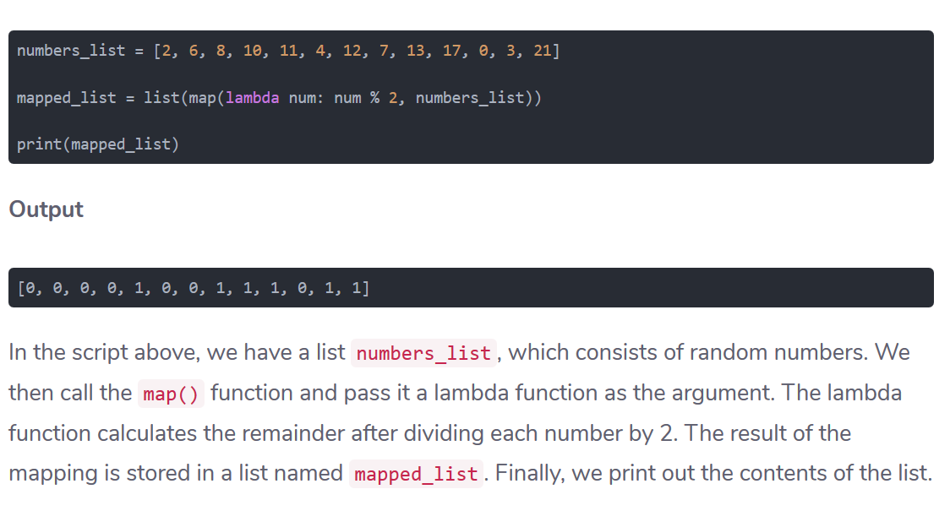
The map() function

Slide 13



Examples

Slide 14
Conclusion
In Python, a lambda function is a single-line function declared with no name, which can have any number of arguments, but it can only have one expression.
Such a function is capable of behaving similarly to a regular function declared using the Python's def keyword.
Often times a lambda function is passed as an argument to another function.

